Slide 1

CPRG 307 Slides are part of the Instructor Resources for the course required textbook and are provided with permission from the publisher:
Oracle 11g: PL/SQL Programming
Joan Casteel
978-1-133-94736-3
Course Technology (Cengage Learning)
Oracle11g:
PL/SQL Programming
Chapter 9
Database Triggers

Slide 2
Database Trigger Defined
Triggers are similar to procedures and functions but will execute automatically based on an event
Events are either DML statements or database system actions
Triggers will fire regardless of the source of the event
DML triggers are specifically associated with a table or view
Oracle11g: PL/SQL Programming

Slide 3
Create DML Trigger Syntax
CREATE OR REPLACE TRIGGER <trigger name>
{BEFORE | AFTER}
{INSERT | DELETE | UPDATE | <multiple>}
[OF <column name>]
ON {<table name> | <view name>}
[FOR EACH ROW]
[WHEN <condition>]
[DECLARE]
<local variables declared....>
BEGIN
<trigger body code.....>
END;
/
CPRG 307

Slide 4
Prefix Suggestions
The prefix of the trigger name should be descriptive so it is known, without looking at the details, the type of triggering action that is involved:
  b[efore] or a[fter]
  i[nsert], u[pdate], and/or d[elete]
  s[tatement] or r[ow]
Example: enrolment_update_aius
  This trigger runs AFTER the INSERT or UPDATE on the enrolment table at a statement level.
CPRG 307

Slide 5
Example Trigger
1 CREATE OR REPLACE TRIGGER product_inventory_trg
2 AFTER UPDATE OF orderplaced ON bb_basket
3 FOR EACH ROW
4 WHEN (OLD.orderplaced <> 1 AND NEW.orderplaced = 1)
5 DECLARE
6 CURSOR basketitem_cur IS
7 SELECT idproduct, quantity, option1
8 FROM bb_basketitem
9 WHERE idbasket = :NEW.idbasket;
10 lv_chg_num NUMBER(3,1);
11 BEGIN
12 FOR basketitem_rec IN basketitem_cur LOOP
13 IF basketitem_rec.option1 = 1 THEN
14 lv_chg_num := (.5 * basketitem_rec.quantity);
15 ELSE
16 lv_chg_num := basketitem_rec.quantity;
17 END IF;
18 UPDATE bb_product
19 SET stock = stock – lv_chg_num
20 WHERE idproduct = basketitem_rec.idproduct;
21 END LOOP;
22 END;
Oracle11g: PL/SQL Programming

Slide 6
Trigger Timing
AFTER or BEFORE event
ROW level or STATEMENT level
WHEN clause provides conditional processing
Oracle11g: PL/SQL Programming

Slide 7
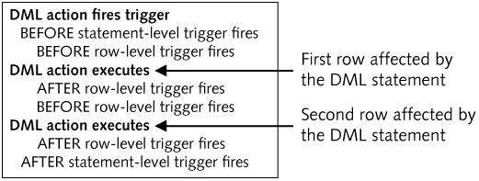
Trigger Timing
Oracle11g: PL/SQL Programming

Slide 8
Trigger Event
INSERT, UPDATE, DELETE
  Use the OR operator to include more than one event in a trigger
OF column_name option (UPDATE trigger only)
ON table_name
Oracle11g: PL/SQL Programming

Slide 9
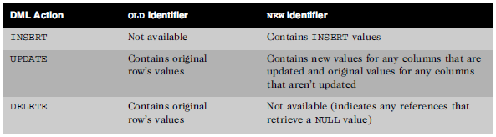
Correlation Identifiers
Special bind variables associated with DML activity
Only available for row level triggers
OLD and NEW by default
Oracle11g: PL/SQL Programming

Slide 10
Trigger Body
PL/SQL block
Must include a DECLARE clause if declarations needed
Can reference correlation identifiers using a preceding colon
Can include calls to other program units
Oracle11g: PL/SQL Programming

Slide 11
Conditional Predicates
IF INSERTING, IF UPDATING, IF DELETING
Supports different processing to occur for each type of DML statement since multiple DML actions can fire a trigger
Can specify a specific column also:
IF UPDATING (‘lastname’) THEN…
Oracle11g: PL/SQL Programming

Slide 12
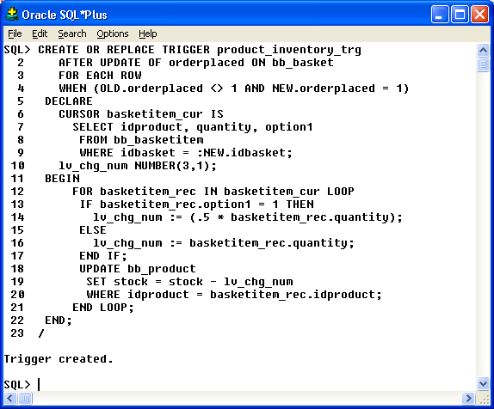
Create Trigger in SQL*Plus
Oracle10g Developer: PL/SQL Programming

Slide 13
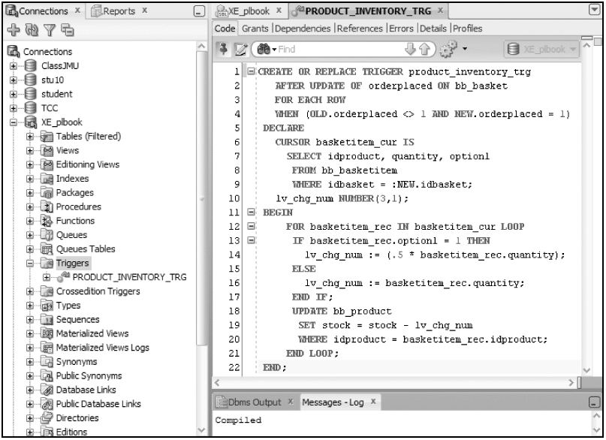
Create Trigger
Oracle11g: PL/SQL Programming

Slide 14
Trigger Firing Sequence
If multiple triggers exist on a table, the order of execution is as follows:
  Before Statement level triggers
  Before Row level triggers
  After Row level triggers
  After Statement level triggers
If more than one trigger exists at the same level, there is no guarantee in the firing order for Oracle 10g and below.
CPRG 307

Slide 15
Trigger Firing Sequence
With Oracle 11g, can now order triggers that are at the same level with the FOLLOWS clause.
CREATE OR REPLACE TRIGGER update_faculty_bur
BEFORE UPDATE ON faculty
FOR EACH ROW
FOLLOWS insert_faculty_bir
BEGIN
....
END;
/
CPRG 307

Slide 16
Compound Triggers
New to Oracle 11.1 are Compound Triggers.
Compound triggers allow for a single trigger to be create that incorporates multiple timing points (i.e. before statement, after statement, etc).
This eliminates the need to manage multiple files (one for each timing point) on a single table.
Can add complexity making maintenance more difficult.
CPRG 307

Slide 17
Compound Triggers
Avoid table mutation issues with triggers (to some degree)
Allows the different events to share variables
Oracle11g: PL/SQL Programming

Slide 18
Compound Triggers
CREATE OR REPLACE TRIGGER update_faculty
FOR INSERT OR UPDATE ON faculty
COMPOUND TRIGGER
-- Global variables seen by all sections
BEFORE STATEMENT IS
...
END BEFORE STATEMENT;
BEFORE EACH ROW IS
...
END BEFORE EACH ROW;
AFTER EACH ROW IS
...
END AFTER EACH ROW;
AFTER STATEMENT IS
...
END AFTER STATEMENT;
END;
/
CPRG 307

Slide 19
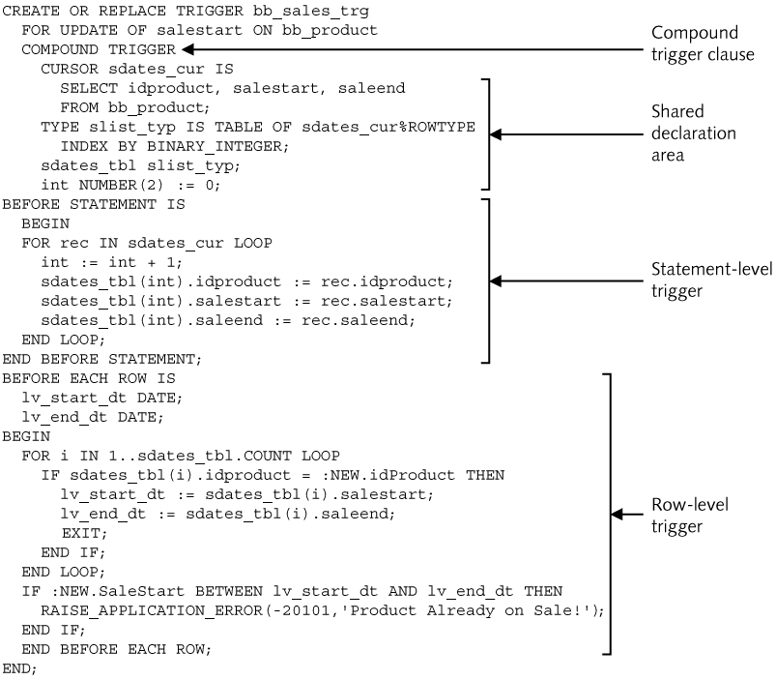
Compound Triggers
Oracle11g: PL/SQL Programming

Slide 20
Instead Of Trigger
Workaround for nonmodifiable view limitations
DML activity on a view will fire an Instead Of trigger
DML activity in the trigger will execute against the base tables using values from the triggering event
Oracle11g: PL/SQL Programming

Slide 21
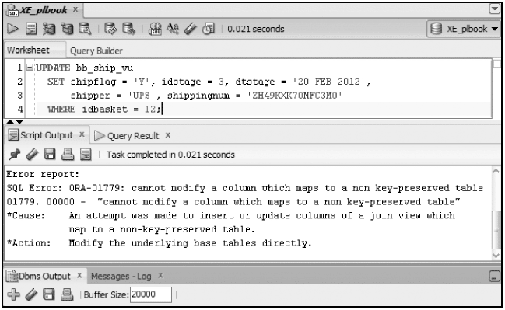
Instead Of Example
Oracle11g: PL/SQL Programming

Slide 22
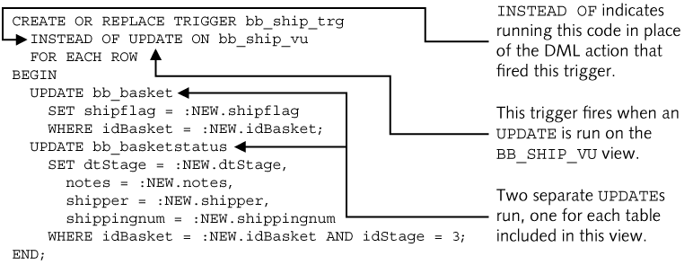
Instead Of Example
Oracle11g: PL/SQL Programming

Slide 23
System Triggers
DDL and database system events
CREATE
RENAME
COMMENT
ALTER
TRUNCATE
ASSOCIATE STATISTICS
DROP
ANALYZE
DISASSOCIATE STATISTICS
GRANT
AUDIT
REVOKE
NOAUDIT
Oracle11g: PL/SQL Programming

Slide 24
System Trigger Syntax
CREATE [OR REPLACE] TRIGGER trigger_name
[BEFORE, AFTER]
[List of DDL or Database System Events]
[ON DATABASE | SCHEMA]
Trigger body;
ON DATABASE – will cause trigger to fire regardless of schema in which the trigger event originated
ON SCHEMA – only fires when event occurs in the same schema in which the trigger was created
Oracle11g: PL/SQL Programming

Slide 25
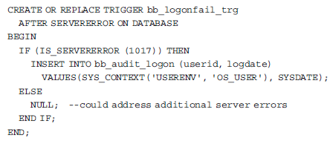
System Trigger Example
Capture failed login attempt information
Oracle11g: PL/SQL Programming

Slide 26
Applying Triggers
Task Type
How a Trigger May be Applied
Auditing
Log files of database activity are widely used. An example would be tracking sensitive data modifications such as employee payroll data. A trigger could be used to write the original and new values of the employee salary update to an audit table. If any questions arise concerning the change, a record of the original values and new values assigned is now available.
Data integrity
Simple data validity checks can be accomplished with CHECK constraints. However, more complex checks or checks that require comparison to a live data value from the database can be accomplished using triggers. A trigger could be used to ensure that any changes to the regular price of a product do not allow a decrease from the current price. The NEW and OLD price values can be compared in a trigger.
Referential integrity
Foreign key constraints are used to enforce relationships between tables. If a parent key value is modified, such as a department number, a foreign key error occurs if we still have products assigned to that department. Triggers provide a way to avoid this error and accomplish a cascade update action.
Oracle11g: PL/SQL Programming

Slide 27
Applying Triggers (continued)
Task Type
How a Trigger May be Applied
Derived data
We may have columns that hold values that are derived from using other columns in a calculation. For example, Brewbean's may have a product sales summary table that holds the total quantity and dollar sales by product. If this table needs to be updated in real time, then a trigger could be used. Every time a new sale is recorded, the trigger would fire and add the new sales amounts to the totals in the sales summary table.
Security
Additional checks on database access can be accomplished such as a simple check on the time of user logon. Some companies use a trigger to determine if it is a weekend day; if so, access is denied. In this case, the company identifies any weekend access as suspicious. (Don’t we wish all companies were like this?!!)
Oracle11g: PL/SQL Programming

Slide 28
Restrictions on Triggers
Cannot issue transaction control statements
Cannot use LONG or LONG RAW data types
Mutating Table error – attempt to modify a table in a row level trigger that is already being modified by the firing event
    The mutating table is the triggering table.
Oracle11g: PL/SQL Programming

Slide 29
Restrictions on Triggers
Constraining table – table referenced via a foreign key of the table being modified in a trigger firing event
  Only an issue if it is a row level trigger.
  Occurs when there is an insert or update in the trigger body on a table that has a foreign key referencing the primary key of the triggering table.
  The constraining table is the triggering table.
  The insert or update in the body of the trigger requires a read on the trigger table to validate the foreign key value.
Oracle11g: PL/SQL Programming

Slide 30
Restrictions on Triggers
No truly elegant way of dealing with mutating tables.
Before 11g, the use of packages as temporary storage was used with two different level triggers.
Starting with 11g, the same idea can be used but everything done in one compound trigger.
The solution to mutating tables is beyond the scope of this course.
Oracle10g Developer: PL/SQL Programming

Slide 31
Enable/Disable Triggers
Prior to 11g, the only way to disable a trigger (an then re-enable it) was through an ALTER TRIGGER statement.
With 11g, can now disable a trigger at creation time.
CREATE OR REPLACE TRIGGER update_faculty_bur
BEFORE UPDATE ON faculty
FOR EACH ROW
DISABLE
BEGIN
....
END;
/
CPRG 307

Slide 32
ALTER TRIGGER statement
Used to compile or disable/enable a trigger
ALTER TRIGGER trigger_name COMPILE;
ALTER TRIGGER trigger_name DISABLE|ENABLE;
ALTER TABLE table_name DISABLE|ENABLE ALL TRIGGERS;
Oracle11g: PL/SQL Programming

Slide 33
Delete a Trigger
DROP TRIGGER trigger_name;
Note: If a table or view is dropped, any associated DML triggers will automatically be deleted
Oracle11g: PL/SQL Programming

Slide 34
Data Dictionary
Same as other program units except for viewing the source code
  USER_TRIGGERS to view trigger source code
Description column contains the header code
Trigger_body column contains the body code
Oracle11g: PL/SQL Programming

Slide 35
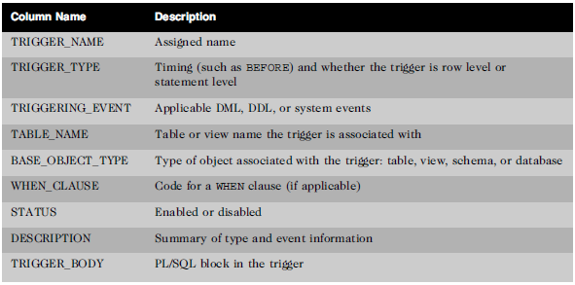
Data Dictionary
USER_TRIGGERS columns
Oracle11g: PL/SQL Programming

